Slide 1


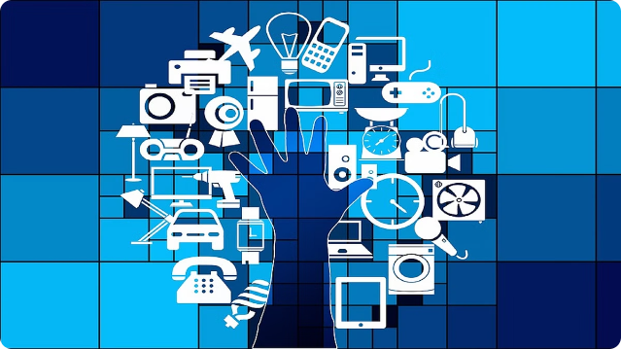


Introduction to IoT (Internet of Things)
The Internet of Things (IoT) is a revolutionary technology that connects various devices, sensors, and systems to the internet, enabling the exchange of data and automation of tasks. It has the potential to transform industries and improve our daily lives.
swaraj kumar | LinkedIn
@crosXplatform

Slide 2
What is IoT and How it Works
Definition
Key Components
Working Principle
IoT is a network of interconnected devices, sensors, and systems that can collect, analyze, and exchange data without human intervention.
IoT systems typically include connected devices, network connectivity, data processing, and cloud-based platforms to store and analyze data.
Sensors in IoT devices gather data, which is then transmitted over a network to a central system for processing and analysis, enabling automation and decision-making.

Slide 3

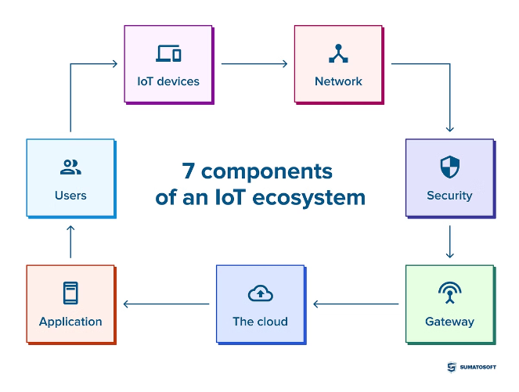
Key Components of an IoT System
Connected Devices
IoT systems rely on a variety of connected devices, such as sensors, actuators, and smart appliances, to gather and transmit data.
Network Connectivity
Devices in an IoT system communicate through various network protocols, such as Wi-Fi, Bluetooth, or cellular networks, to exchange data.
Data Processing
IoT platforms analyze the data collected from connected devices, enabling real-time decision-making and automation.
Cloud Infrastructure
Cloud-based platforms provide scalable storage and computing power to manage and process the vast amounts of data generated by IoT systems.

Slide 4

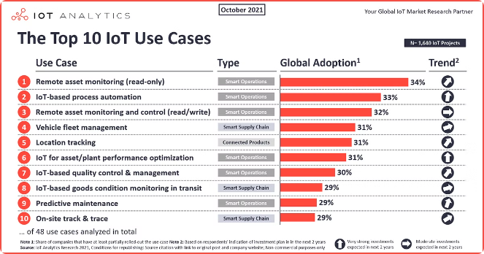
IoT Applications and Use Cases
1
Smart Home
IoT enables the automation and remote control of household appliances, lighting, and security systems, improving energy efficiency and convenience.
2
Industrial Automation
IoT can optimize manufacturing processes, monitor equipment, and predict maintenance needs, increasing productivity and reducing downtime.
3
Healthcare
IoT-powered wearable devices and remote monitoring can improve patient care, enable early disease detection, and support personalized treatment plans.
4
Smart Cities
IoT can be used to manage traffic, optimize energy consumption, enhance public safety, and improve the overall quality of life in urban areas.

Slide 5

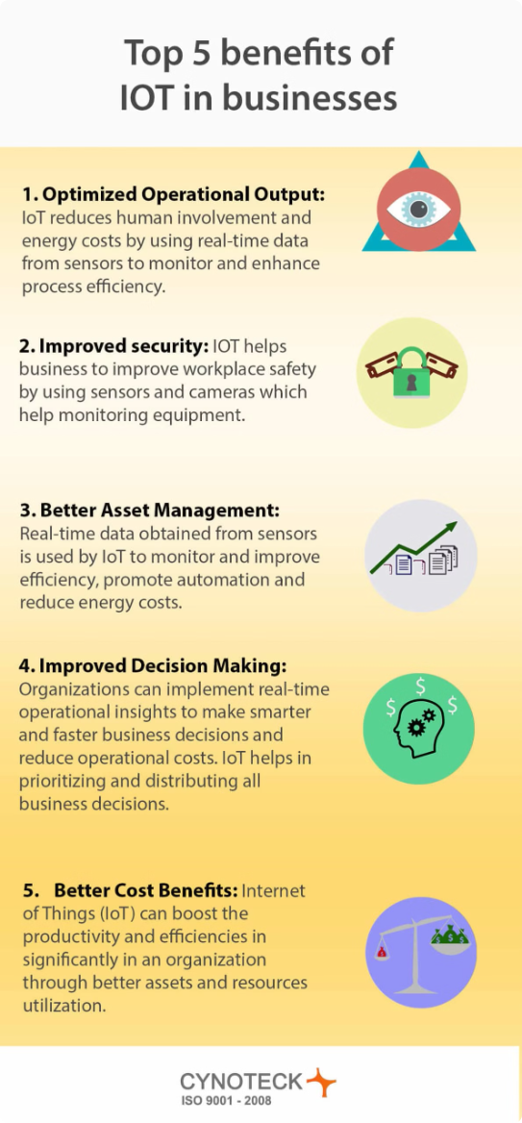




Benefits of IoT for Businesses and Individuals
Increased Efficiency
IoT can automate and optimize business processes, reducing manual intervention and improving overall productivity.
Cost Savings
IoT can help businesses and individuals save money by optimizing resource usage, reducing waste, and enabling predictive maintenance.
Improved Decision Making
IoT data and analytics can provide valuable insights to help businesses and individuals make more informed decisions.
Enhanced User Experience
IoT can personalize and automate various aspects of our daily lives, improving convenience and overall quality of life.

Slide 6


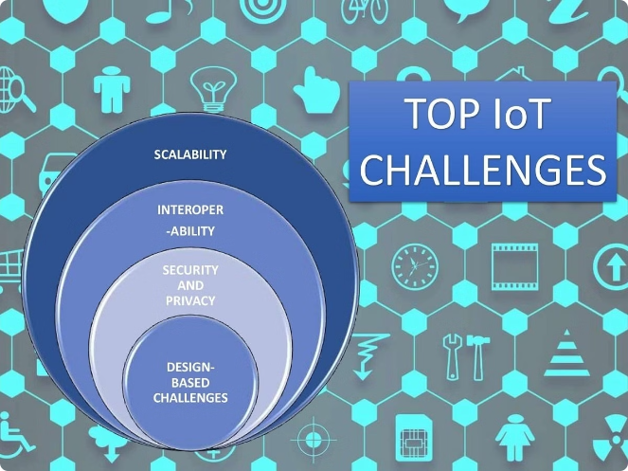



Challenges and Limitations of IoT
Security and Privacy
IoT devices can be vulnerable to cyber threats, and the collection and use of personal data raise concerns about privacy.
Interoperability
The lack of standardized protocols and communication methods can make it challenging to integrate different IoT systems and devices.
Data Management
The vast amount of data generated by IoT systems requires robust data management, storage, and analytics capabilities to extract meaningful insights.
Power Consumption
Many IoT devices are battery-powered, and their energy consumption needs to be optimized to ensure long-term operation.

Slide 7
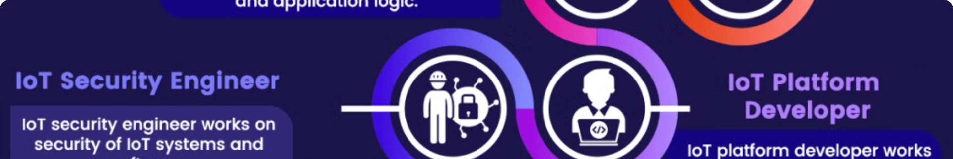
IoT Job Opportunities and Career Paths
IoT Engineer
IoT Project Manager
Responsible for designing, developing, and implementing IoT systems and devices.
Oversees the planning, coordination, and execution of IoT projects, ensuring they meet business objectives.
1
2
3
IoT Data Analyst
Analyzes and interprets the data collected by IoT systems to uncover insights and drive decision-making.

Slide 8

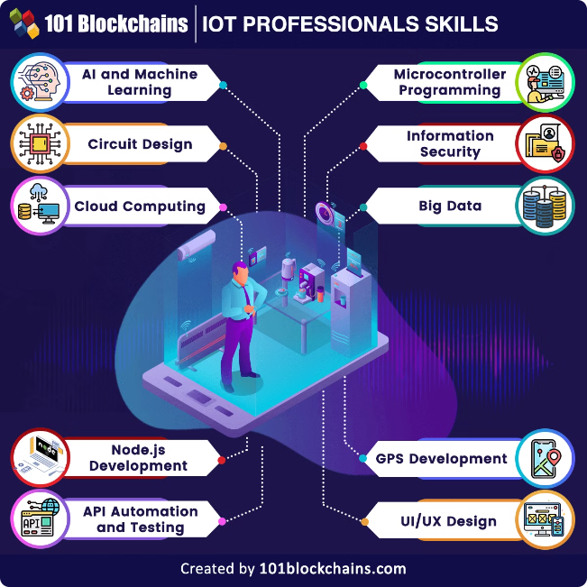
Skills and Qualifications Needed for IoT Jobs
Technical Skills
Programming (e.g., Python, Java, C++), Networking, Embedded Systems, Cloud Computing, Cybersecurity
Analytical Skills
Data Analysis, Machine Learning, Predictive Modeling, Decision-Making
Project Management
Project Planning, Resource Allocation, Stakeholder Management, Risk Mitigation
Industry Knowledge
Understanding of specific industry applications, regulations, and best practices

Slide 9
IoT Industry Trends and Future Outlook
Edge Computing
Artificial Intelligence and Machine Learning
5G and Faster Connectivity
The rise of edge computing, where data processing happens closer to the source, will enable real-time decision-making and improved efficiency in IoT systems.
The deployment of 5G networks will provide the high-speed, low-latency connectivity required for advanced IoT applications, such as remote control and real-time monitoring.
The integration of AI and ML algorithms will enhance the predictive capabilities of IoT systems, leading to more intelligent and autonomous decision-making.

Slide 10

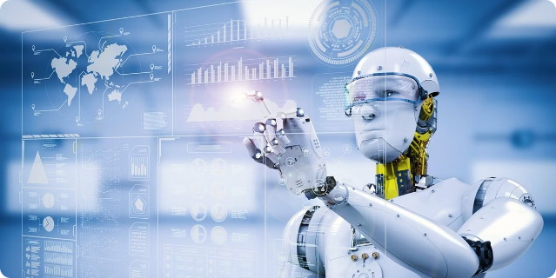
Conclusion and Next Steps
1
Conclusion
IoT is a transformative technology that is revolutionizing industries and improving our daily lives. As the technology continues to evolve, the opportunities for IoT-related careers are expected to grow rapidly.
2
Next Steps
If you're interested in exploring the world of IoT, consider learning more about the technology, its applications, and the skills required for IoT-related jobs. Attend online courses, participate in IoT-focused events, and connect with industry professionals to kickstart your IoT journey.

